Slide 1
Big Data Privacy Requirements Engineering
Literature review and Research Gap
Daniel Servos
CS9864 Software Engineering for Big Data Applications and Analytics
April 29th, 2016

Slide 2
Literature Review

Slide 3
Literature Review
Enforcement,
Policy, Issues
& Awareness
Privacy
Big Data
Big Data Privacy
Requirements
Engineering
Privacy
Requirements
Engineering
Big Data
Requirements
Engineering
Requirements
Engineering

Slide 4
Szongott, C., Henne, B., & von Voigt, G. (2012, June). Big data privacy issues in public social media. In Digital Ecosystems Technologies (DEST), 2012 6th IEEE International Conference on (pp. 1). IEEE.
Privacy
Big Data
Requirements
Engineering

Slide 5
Summary
Szongott, C., et al. describe the implications of geo-tagging photos and videos on social media and provide an analysis of the image meta-data shared by popular social media sites. Privacy issues resulting on the user side (as opposed to the back end system side) are discussed and a potential solution in the form of a new Big Data watchdog application is suggested.

Slide 6
Big Data problem on the user’s side
Microsoft’s Scott Charney offered a good example during his Keynote speech at the RSA Conference 2012:
“If a friend takes a picture of me during a volleyball game, shares this picture with other friends and one of them uploads the picture to the web, my insurance company can find and use that picture against me”

Slide 7
“…the flood of media uploaded by others is so huge that it is almost impossible to stay aware of all media in which one might be depicted.”
While current social media platforms provide controls for a user to protect the privacy of the content they upload, little is done to deal with the privacy implications created by other user’s media.
Images and videos of a person may be upload to social media platforms that the person is not even a member of. Geo-tagging and other meta data potentially make the problem worse.

Slide 8
Identification and categorization of privacy issues
Categorize privacy issues into two classes:
Homegrown problems: “Someone uploads a piece of compromising media of himself with insufficient protection or forethought which causes damage to his own privacy.”
What is considered damaging content by the user can and change over time.
Small data problem, not the focus of this work.
Big Data problems created by others: “Emerging threat to users’ online privacy comes from other users’ media.”
Two requirements for this to be a privacy issue: first the piece of media needs to be linked to the person in some way (e.g. tagging) and second the piece of media in question must be considered harmful to the person.

Slide 9
Privacy analysis of different media hosting sites
Flickr provides the most fine-grained privacy/access control.
Analysed a set of 5.7k random publicly available Flickr images and their metadata and 1k mobile user Flickr photos

Slide 10
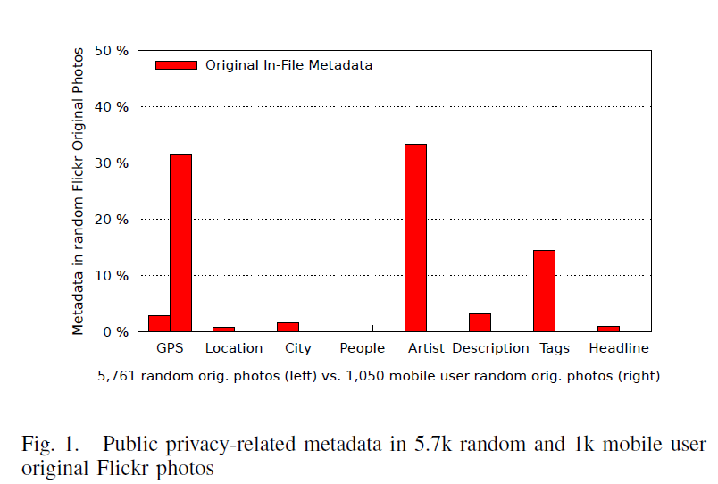
GPS location data was present in 19% of the 5.7k dataset and in 34% of the 1k mobile phone dataset.

Slide 11
Also analyzed images from Locr, an image sharing service focused around sharing images by location.
5k random photos from Locr service analyzed for meta-data.

Slide 12
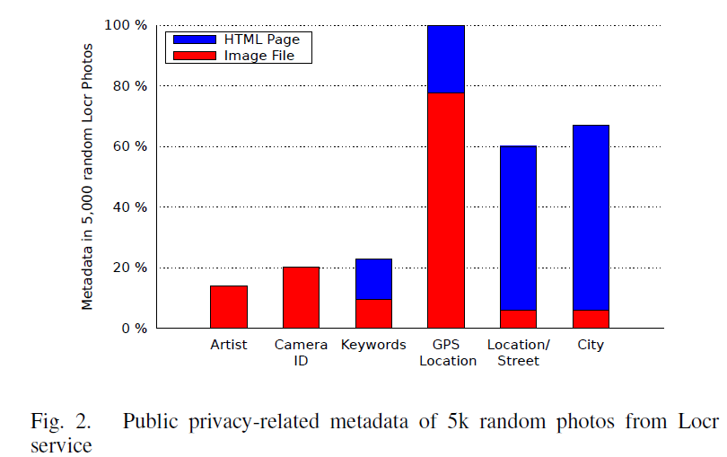
100% had GPS location data due to the nature of the service, but interestingly a high percent also had street addresses and city names in the meta-data.

Slide 13
Proposed Solution
Propose leveraging the location tracking capability of modern smartphones to create “smart privacy zones”.
Using a GPS enabled mobile device users can use their app to create “privacy zones”, locations that may be sensitive or relevant to a user’s privacy.
Watchdog service then shows/notifies user a feed of media currently being posted in these privacy zones during the time the user was present in them.

Slide 14
Provides awareness of potential privacy violations but can not prevent them.
Downside is the service it’s self introduces new privacy considerations as it is constantly tracking the users location.
Paper suggests some methods for mitigating new concerns (e.g. using service over TOR or also periodically sending fake locations).

Slide 15
Main Salient Points
Big Data problem on the user’s side
Privacy issues relating to Big Data happen not only in regards to protecting user data on the back end but can result from actions of other users.
Example problem: Users are unable to be aware of all photos uploaded of them on all social media sites. Too much data for a user to go through manually.
Identification and categorization of privacy issues
We need to know about and understand possible privacy issues before we develop proper privacy requirements.
Work is needed that summarizes and categorizes privacy and possible privacy concerns in Big Data such that proper privacy requirements can be developed.

Slide 16
Breaux, T. D., & Rao, A. (2013, July). Formal analysis of privacy requirements specifications for multi-tier applications. In Requirements Engineering Conference (RE), 2013 21st IEEE International (pp. 14). IEEE.
Privacy
Big Data
Requirements
Engineering

Slide 17
Summary
Breaux, T. D, et al. discuss privacy issues resulting from multi-tier applications. That is, applications that involve multiple levels or “tiers” that may be owned by different actors. The use case discussed in detail is Facebook and their application providers. In these cases, Facebook shares user data with application providers under a given privacy policy whom in turn, may further share this data under their own privacy policy.
Breaux, T. D, et al. provide a method for mining privacy requirements from existing natural language privacy policies as well as tools from finding potential conflicts in the resulting requirements.

Slide 18
The Facebook/Zynga Use Case
Facebook allows user data to be provided to first party advertisers (i.e. advertisers working directly with Facebook) and application developers. However, their privacy policy forbids user data from being shared with third party ad networks.
Zynga is a Facebook app developer that makes the popular game Farmville. Zynga’s privacy policy allows them to share user data with their advertisers but only with third parties if you give explicit consent.

Slide 19
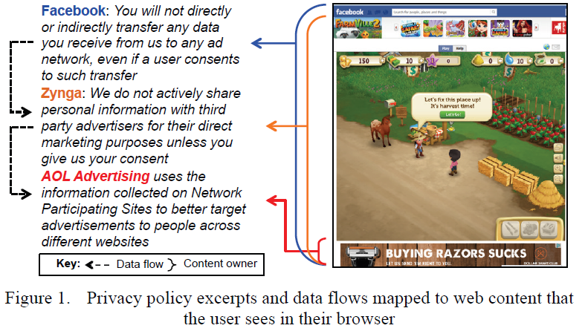
AOL Advertising is an advertiser that buys ad space directly from Zynga in their Farmville app. AOL’s privacy policy allows user data to be shared with anyone for targeting advertising.

Slide 20
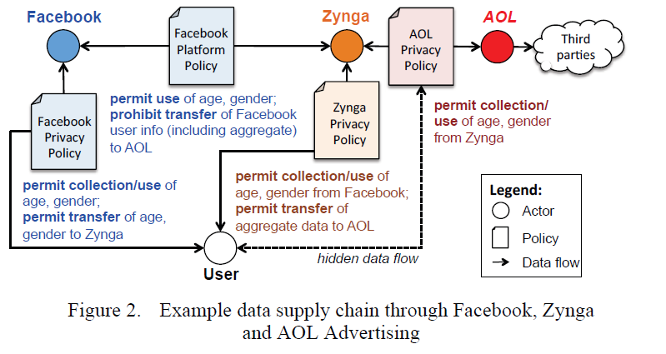
Problem: Privacy policies are in conflict. Facebook forbids user data from being used by third party ad networks but shares data with Zynga. Zynga allows data to be shared with AOL. AOL allows data to be shared with third party ad networks.

Slide 21
Solution
Breaux, T. D, et al. provide a method for mining privacy policies to produce privacy requirements in their own SQL like language.
This language can be converted into Description Logic (a first-order logic for expressing knowledge) and used in reasoning tools to detect potential conflicts.

Slide 22
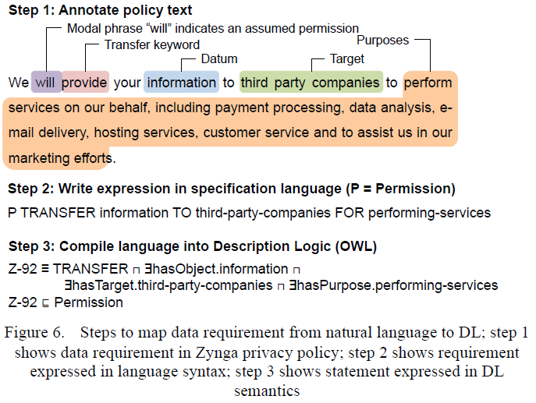

Slide 23
Evaluation
They evaluate their tool by creating privacy requirements based on the privacy policies of Facebook, Zynga and AOL Advertising.
Resulting requirements found three conflicts between Facebook and Zynga’s privacy policies and one conflict the AOL policy had with it’s self.
Simulation also showed that the tools used by the researchers scaled linearly with the sizes of the privacy policies.

Slide 24
Main Salient Points
Discovery of conflicts between policy requirements
Breaux, T. D, et al. show that conflits can exist between the privacy requirements of different organizations that share data as well as in some cases, conflicts with an organizations own requirements.
They provide a means for automatically detecting such conflicts.
Mining privacy requirements from existing privacy policies.
It is likely that clients will not fully know their privacy requirements when specifying software. This leaves the potential for conflicts between what is required and what an organizations natural language privacy policies state.
Developing privacy requirements based on existing privacy policies helps eliminate such conflicts.

Slide 25
Thomas Scheffler, Bettina Schnor, “Privacy Requirements For Embedded Sensor Devices”. 2005 IEEE 16th International Symposium on Personal, Indoor and Mobile Radio Communications
Privacy
Big Data
Requirements
Engineering

Slide 26
Summary
Scheffler T., et al. analyses the privacy issues that arise from the deployment of sensors in embedded devices and propose an atomic privacy parameter language for documenting high-level privacy requirements. Possible privacy issues in such sensor networks are divided into three cases based on the who owns the systems along the data analytics processing chain.

Slide 27
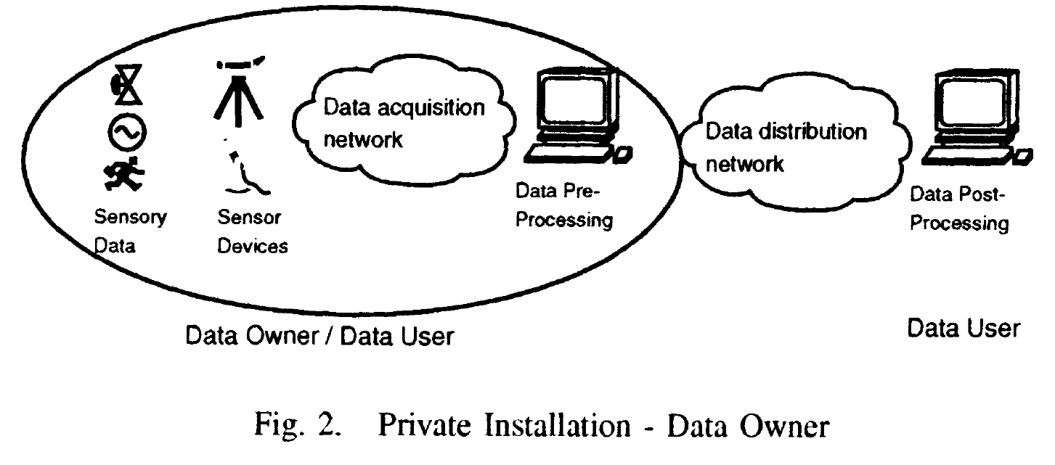
In the first case, they discuss the data owner (i.e. that person to whom the data describes) also owns the sensor device and controls the pre-processing stage.
Example given is a home network where a number of networked devices can be monitored by the home owner and reports sent to the manufacture at the home owners discretion.
They conclude that no special privacy requirements are needed in this case as the data owner has full control.

Slide 28
In the second case, the data owner does not own any part of the data processing chain. Both the pre-processing and post-processing stages are owned by a private data user that does not share the data with third parties with out the data owners consent.
Example given is mobile telephone networks where a provider can track and location and usage of devices on it’s network.
They conclude that no special privacy requirements are needed as the user has to agree to the providers privacy and usage policies so they aware of the privacy issues involved.

Slide 29
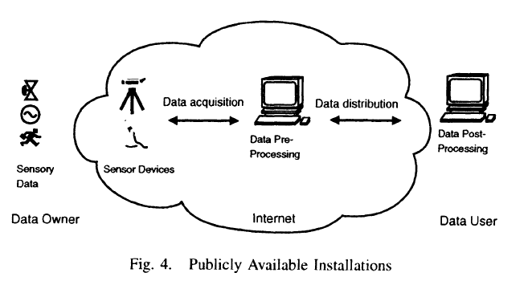
The third case describes a sensor network deployed such that the data owner may not be aware of the data collection and the raw data (in the data pre-processing stage) may be publicly available.
As no agreement is made with the data owner and the data may be made available publicly, it is argued that in this case special privacy requirements are needed.

Slide 30
The following privacy risks are identified in regards to sensor networks:
“Secrecy is at risk when the whereabouts, the preferences and actions of an individual become publicly available.”
“Sensor networks have the potential to identify and attribute previously anonymous actions of the data owner, possibly without her knowledge or consent.”
“The solitude of the data owner is at risk through the surveillance potential of embedded and networked devices in the home and other places.”

Slide 31
Solution
Scheffler T., et al. argue that privacy protection in the third case must start at the source (the sensor device) and that privacy requirements are needed for each individual device.
They provide a high-level atomic privacy parameter language for documenting high-level requirements (i.e. ones that apply to a whole system and not individual devices).
Converting this high-level language into device specific policies/requirements is left to future work.

Slide 32
Main Salient Points
Mapping of privacy requirements into high-level privacy policies
Representing privacy requirements in formal or semi-formal high-level privacy policies allows for a common way to talk and reason about privacy requirements.
They claim works is underway towards an automated process that would help break high-level system wide privacy requirements into device specific requirements.

Slide 33
Jutla, D. N., Bodorik, P., & Ali, S. (2013, June). Engineering privacy for big data apps with the unified modeling language. In Big Data (BigData Congress), 2013 IEEE International Congress on (pp. 38). IEEE.
Privacy
Big Data
Requirements
Engineering

Slide 34
Summary
Jutla, D. N., et al. demonstrate an extension to UML use case diagrams to support notions of privacy and Big Data. Their extensions are implemented as a new ribbon for Microsoft Visio UML diagrams called the Privacy by Design (PbD) ribbon.
Jutla, D. N., et al. evaluate their extension by showing how it is able to model parts of the privacy requirements for a Big Data health care use case.

Slide 35
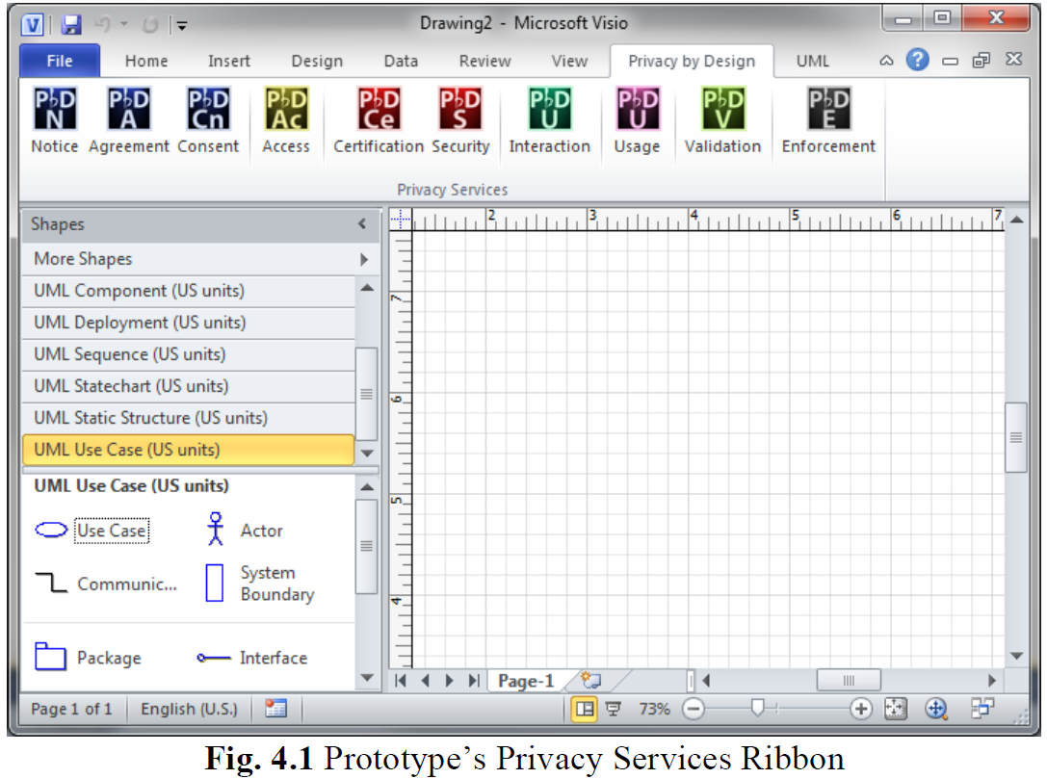

Slide 36
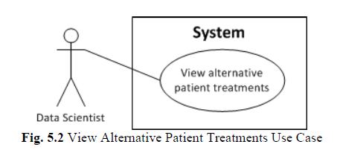
Ribbon allows users to drag and drop privacy services into their UML use case diagram.
Example:
This figure shows a simple traditional use case where a data scientist is able to view alternative patient treatments. However, no privacy requirements are shown/documented.

Slide 37
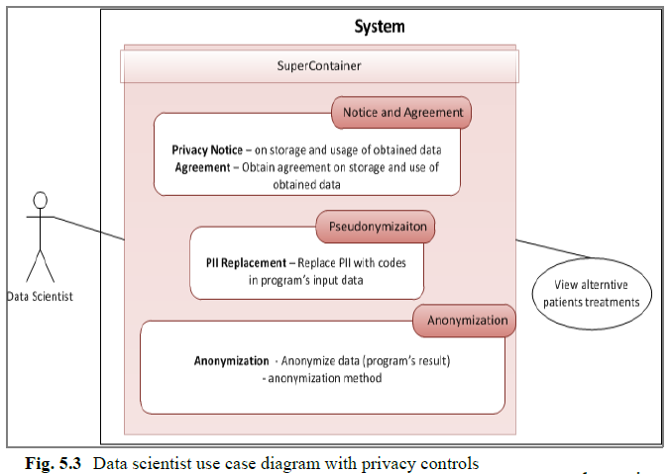
With the extensions the use case with privacy requirements would look like so:

Slide 38
The super container on the line between the actor and the view represents the privacy requirements that must be met for this communication to proceed.
In this case the certain data must be anonymized and an agreement is required in regards to the storage and use of the data.

Slide 39
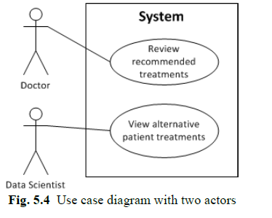
The same notation can also be used to describe use cases with multiple actors and views.
For example for this traditional UML use case:
That adds a doctor that needs to review recommended treatments. The following extended UML diagram can be used to show privacy requirements.

Slide 40
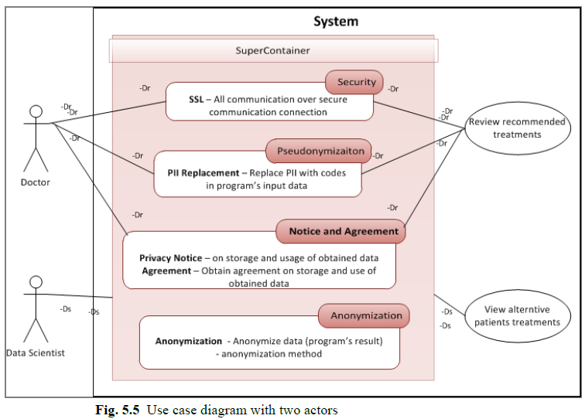
In this case lines are denoted with “Dr” or “Ds” to shown the actor they apply to.

Slide 41
The data scientist has a line connecting them to the super container directly and not an individual privacy requirement. This indicates that all requirements apply to this actor.

Slide 42
The doctor has lines connecting them to specific requirements. This indicates that these are the only requirements that apply to their communication with the connected view.

Slide 43
Main Salient Points
New software engineering tools for privacy and Big Data requirements engineering
New tools are needed to visually document the requirements and characteristics of Big Data systems in traditional software engineering diagrams.
This work provides a start towards extending the UML use case diagram to support privacy notations in a Big Data setting.
Privacy by design rather than after the fact
Many of the current solutions to privacy in Big Data are extensions or additions to existing systems tacked on after the requirements and design phase. New methods are needed that support privacy by design from the beginning of the requirements phase and not as an afterthought.
This work provides a tool for incorporating privacy by design in the use case modeling phase of system development.

Slide 44
Eridaputra, H., Hendradjaya, B., & Sunindyo, W. D. (2014, November). Modeling the requirements for big data application using goal oriented approach. In Data and Software Engineering (ICODSE), 2014 International Conference on (pp. 1). IEEE.
Privacy
Big Data
Requirements
Engineering

Slide 45
Summary
Eridaputra, H., et al. models the general requirements of Big Data applications using a goal oriented approach and formalizes them in both the i* and KAOS models. The i* and KAOS models are evaluated based on how well the produced requirements meeting a real world Big Data use case. Feedback from a real client is used to determine the appropriateness of the resulting requirements.

Slide 46
Goal Oriented Requirements Engineering
Goal oriented requirements engineering (GORE) focuses on the goals of a project rather than traditional requirements.
The idea is to not model “what” the system should do (as with traditional requirements engineering) so much as model “why” the system should do something and “how” it can be done.

Slide 47
There are a number of GORE models to choose from, the paper uses i* and KAOS as they are among the most popular.
i* models organizations based on the dependency relationship among actors. Actors depend on each other such that the goal can be achieved, a resource to be provided or a task to be performed.
i* breaks this into two models:
Strategic Dependency (SD) model that shows dependency relations between actors.
Strategic Rationale (SR) model that shows the rationale behind the system and organization.

Slide 48
Knowledge Acquisition in autOmated Specification (KAOS) consist of four models; namely Goal Model, Responsibility Model, Object Model and Operational Model.
The KAOS Goal Model is used by this paper. The Goal Model produces requirements based on a top down hierarchy of goals and sub goals. Starting from the overall goal of the system down to goals specific enough to be requirements.

Slide 49
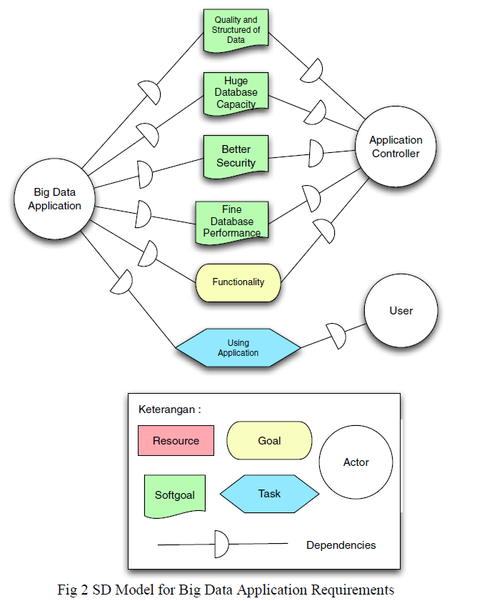
i* SD Model for General Big Data Applications

Slide 50
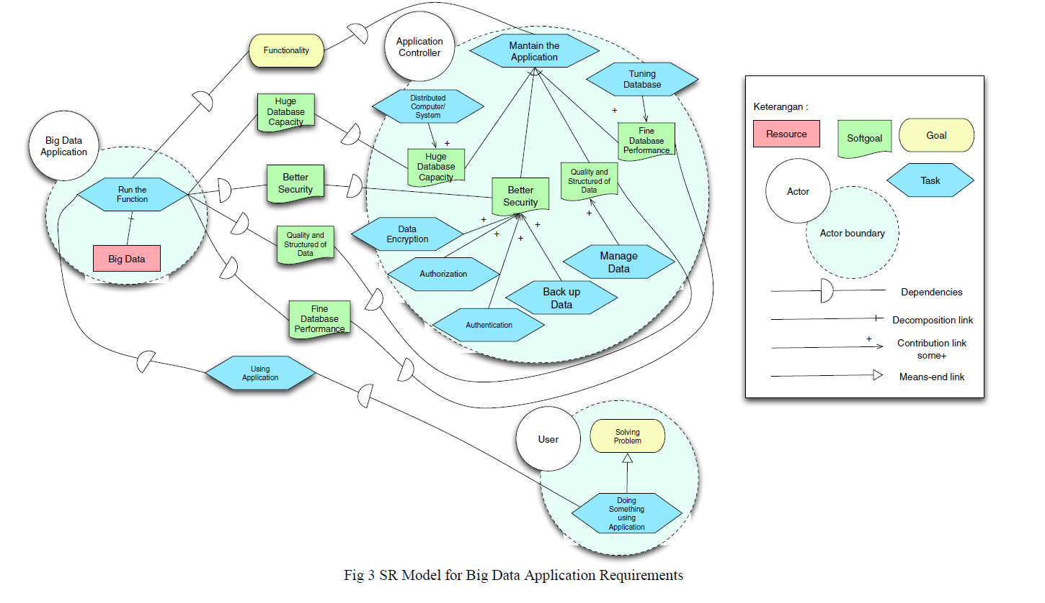
i* SR Model for General Big Data Applications

Slide 51
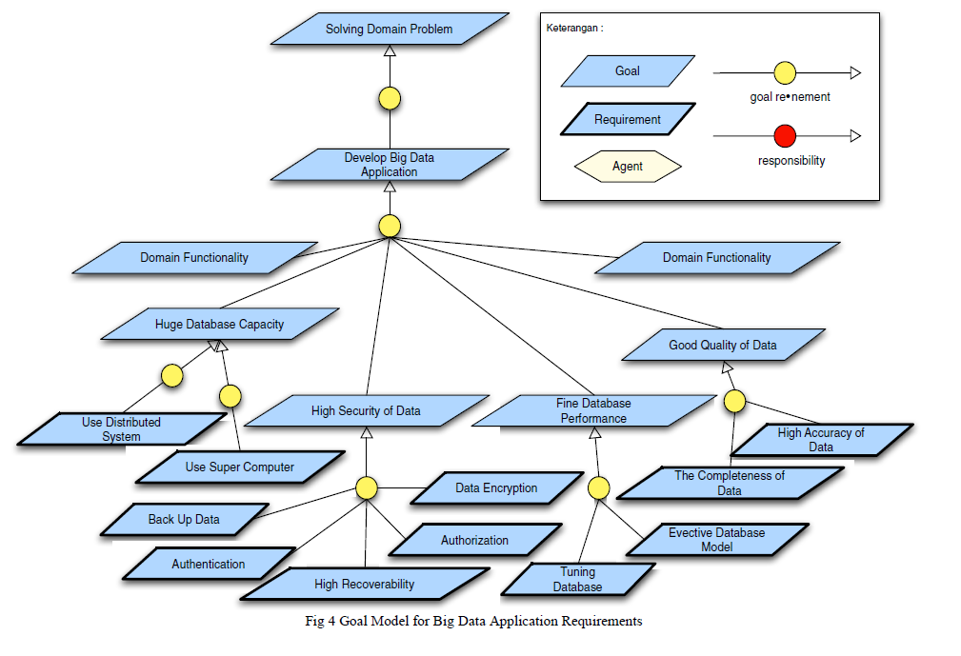
KAOS Goal Model for General Big Data Applications

Slide 52
Evaluation
The i* and KAOS requirements were tested in a specific “real-life” use case involving a Big Data application being created by the Indonesian’s government agency for development planning of West Java.
Unfortunately, the paper provides few details about this specific use case (focusing more on generalized requirements for Big Data) and merely states that the client approved of both the i* and KAOS produced requirements.
The authors conclude that the KAOS model is better than i* model when it comes to generating the model into requirements. However, they also state that the models complement each other and thus both can be used in software project development.

Slide 53
Main Salient Points
Uses a formal requirements model to describe Big Data requirements
This work shows formal requirements for a generalized Big Data application in both i* and KAOS.
Formally specified requirements aid in comparing and analyzing requirements from different systems and projects. As such this work can be used as the foundation for creating requirements for any Big Data application.
Domain independent Big Data requirements
Most of the current efforts towards requirements engineering for Big Data focuses on a specific application domain. In many cases, this limits the applicability of the findings. In this case, the work is generalized for any Big Data application.

Slide 54
Tun, T. T., Bandara, A. K., Price, B. A., Yu, Y., Haley, C., Omoronyia, I., & Nuseibeh, B. (2012, September). Privacy arguments: Analysing selective disclosure requirements for mobile applications. In Requirements Engineering Conference (RE), 2012 20th IEEE International (pp. 131). IEEE.
Privacy
Big Data
Requirements
Engineering

Slide 55
Summary
Tun, T. T., et al. discuss privacy requirements for mobile applications from the end user’s perspective (as opposed to the developer’s or stakeholder’s). They introduce a system where individual users can specify their own privacy requirements at run time and have the system adapt to their needs without modification. This is accomplished through a high-level privacy argument language that allows developers to define default privacy requirements (or “norms”) for the system and user to extend them with their own personal privacy requirements. A proof of connect is provided in the form of the BuddyTracker smartphone app created by the researchers for the purposes of this work.

Slide 56
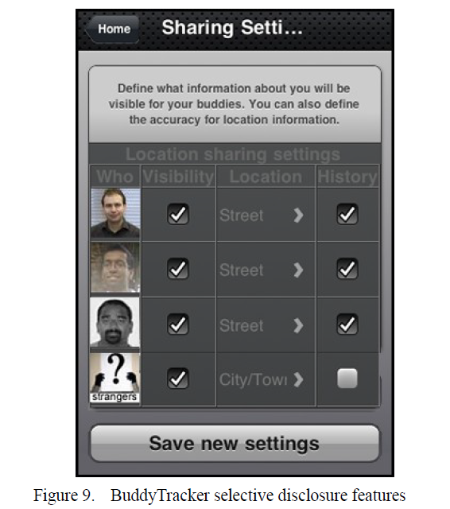
The BuddyTracker application is used both as a proof of concept and a use case by the authors. It is a simple application that shares the user’s location with other users.
By default the developers of BuddyTracker created a default privacy requirement that work colleagues be able to view the location of fellow colleagues. This is specified in their high-level language as follows:

Slide 57
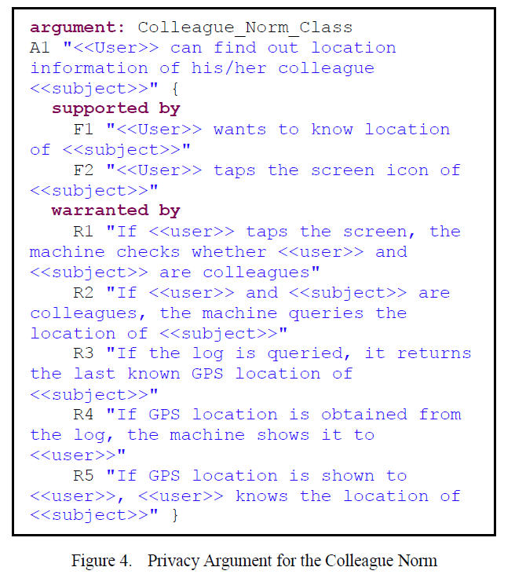

Slide 58
User can then extend this default privacy “norm” with their own requirements. For example, if the user Bob wanted to exclude the user Dave from viewing his location even if he was a colleague he could create the following exception:
Similarly, users are able to state privacy preferences to prefer one policy over another under set contexts. For example, if Bob preferred one policy on the weekend and one on week days he does the following:

Slide 59
The authors provide tools for transforming this high-level language into Event Calculus such that they can be used with reasoning tools to analyze the polices. These tools can also be used to provide explanations to users about why a privacy decision was made, list who has access to their data and notify a user if their personal privacy requirements were not maintained.

Slide 60
Main Salient Points
Deals with end user privacy requirements
Much of the current literature only deals with privacy requirements of the stakeholders and owners of the components of a Big Data system. However, the privacy requirements of individual end users are also important and likely to differ among users and over time.
Adaptation to run-time privacy requirements
In many cases, exact and individual privacy requirements change over the course of a systems life time. A flexible solution, such as that provided by this work, is needed to support frequently changing privacy requirements at run-time.

Slide 61
Research Gap

Slide 62
Big Data Domain Independent Privacy Requirements
While there is research covering privacy requirements in specific Big Data application domains such as health care or social networks, there is little or no work towards generic privacy requirements that are independent of the application domain.
Eridaputra, H., et al. presented generic Big Data requirements but they did not deal with privacy.
Jutla, D., et al. presented an UML extension for modeling privacy requirements in Big Data that may be generic enough to apply to all Big Data domains but this is only a tool for modeling the requirements and says nothing about the requirements them selves.

Slide 63
The other works fail to address this issue:

Slide 64
Generalized application independent privacy requirements would provide a foundation on which privacy requirements could be built for all Big Data applications. This would help ensure the most basic privacy requirements are always present as well as speed up the requirements gather phase (at least for privacy requirements).

Slide 65
Mapping of High-Level Privacy Policies into Device Specific Policies
While much of the work covered dealt with mapping natural language privacy policies into high-level privacy requirements, no work has been done towards taking these high-level system wide requirements and applying them to the individual devices/components of the system. For example, how do you go from a high-level requirement such as “users have to consent to having data about them collected” to “sensor 4356 should not collect information about Bob but can collect information about Alice”. Ideally, an automated solution could take a formal high-level policy and apply it to low level components of the system but so far this has not been accomplished.

Slide 66
Scheffler, T., et al. discuss this as a possible direction of future work for their sensor network privacy requirements but do not provide any details.
The other works do not deal with this issue:

Slide 67
Automation of low-level device specific privacy requirements generated from high-level requirements would aid in both the requirements engineering process as well as ensuring that privacy requirements are maintained at both a high-level and low-level in a given system. In cases like Big Data where a system may involve thousands if not millions of such devices it is critical that this process be automated as it would be impossible manually.

Slide 68
Detailed “real-life” use cases of privacy requirements in Big Data applications
The majority of the research reviewed uses fictional use cases or only uses “real-life” use cases in an extremely limited extent.
Eridaputra, H., et al. state that they evaluated their requirements engineering process with a “real-life” use case but provide no details about the use case or even it’s application domain.
Breaux, T.D., et al. look at a “real-life” use case involving Facebook and Zynga to find privacy requirement conflicts. However, these only represent a subset of the privacy requirements for the mentioned organizations and are not privacy requirements for a specific Big Data application. The resulting privacy requirements are also not evaluated for correctness or how well they are suited to the systems, rather they are intended to identify conflicts in existing requirements.

Slide 69
The other works do not deal with this issue:

Slide 70
Having detailed “real-life” use cases and case studies concerning privacy requirements in Big Data are critical for Big Data requirements engineering research. Without realistic use cases it is difficult to properly evaluate privacy requirements and find their shortcomings.

Slide 71
Conclusions
What is well covered:
Application domain specific privacy requirements.
Identification of privacy concerns and risks in specific domains.
Mapping of existing privacy polices into privacy requirements.
Using formal methods/models to describe privacy requirements.
Application domain specific use cases.
Addressing Big Data privacy issues on the user’s side.

Slide 72
Conclusions
What has limited coverage:
Privacy-by-design for Big Data.
Domain independent requirements for Big Data.
Detecting privacy requirement conflicts.
Dealing with end user privacy requirements.
Dealing with privacy requirements that change at run-time.

Slide 73
Conclusions
What has no coverage:
Domain independent privacy requirements.
Mapping of high-level privacy requirements to low-level devices/components.
Detailed “real-life” use cases and case studies for privacy in Big Data.
Automatic privacy requirements resolution.

